Slide 1
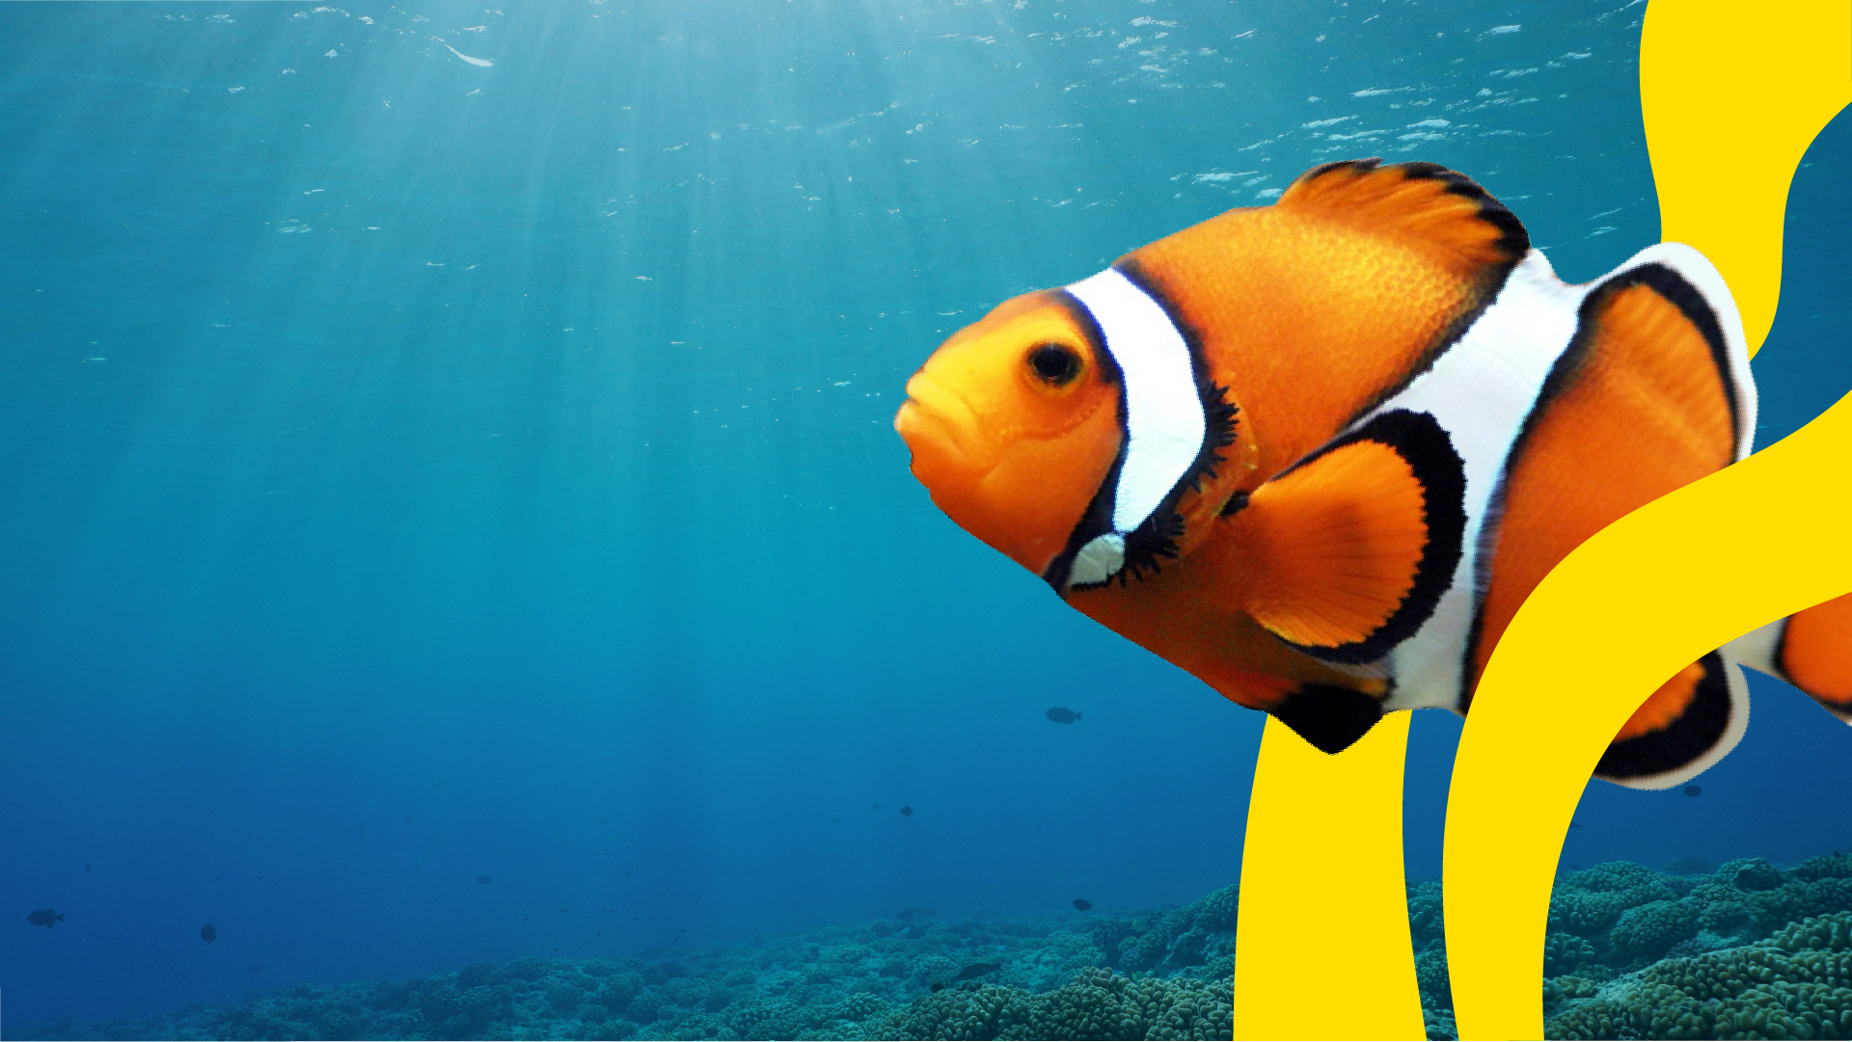

Ocean
Pollution
Post-Visit Lesson Plan
EDUCATION

Slide 2
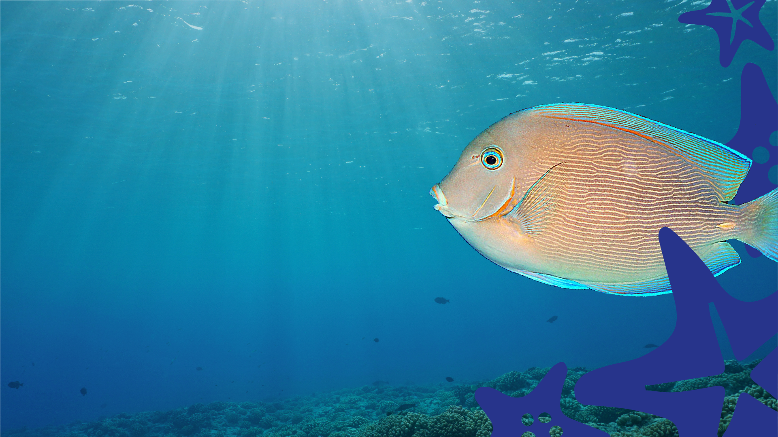
Objectives
To consider the impact of plastic and litter that isn’t recycled on the oceans
To explore and present how waste could be reduced, reused or recycled
Outcomes
A bin-grid record of different items in a school trash bin
A list of problems and solutions
A presentation that persuades school leaders
to become School Recycling Champions
EDUCATION

Slide 3

Think back to your visit to SEA LIFE.
What did you learn?
What did you most enjoy about your visit?
EDUCATION

Slide 4

Following on from your visit to
SEA LIFE, it’s time to investigate
your school’s litter to see how
effectively it is helping the world’s
oceans.
Predict what materials you might find if you were to
empty the bin in the classroom or playground right
now; try not to simply say ‘wrappers’ or ‘bottles’ -
describe the materials the wrappers or bottles
are made from.
EDUCATION

Slide 5
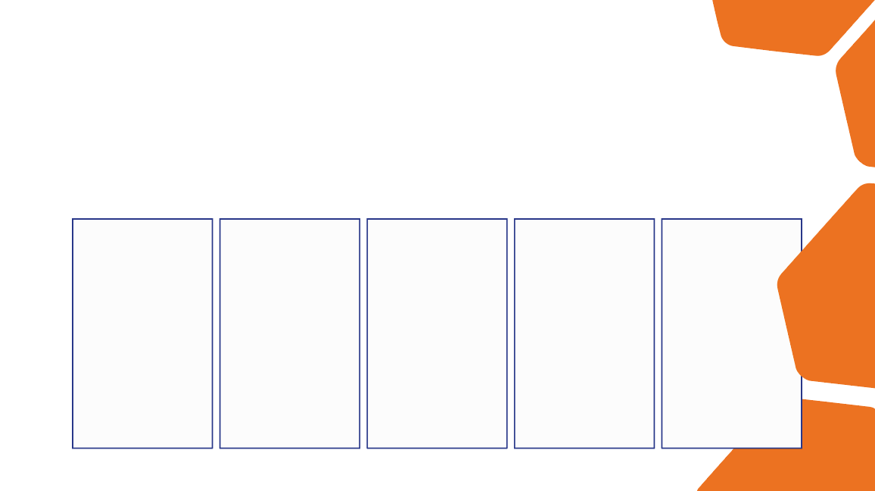
Now it’s time to sort through the litter! Make sure
you wear gloves or wash your hands after touching
anything in the bin. Alternatively, observe what's in
the bin just by laying it out on a covered table.
Record what you find in the bin-grid below.
Plastic
Paper/Card
Cans
Compost
Glass

Slide 6


Oooh!
Compare the results of the litter-sort
with your
predictions in
the first task!
EDUCATION

Slide 7

Discuss the following questions about the litter with a partner:
Which is the most/least common material?
Which materials could be recycled?
Did everything you found need to be thrown away? Could it be reused?
EDUCATION

Slide 8
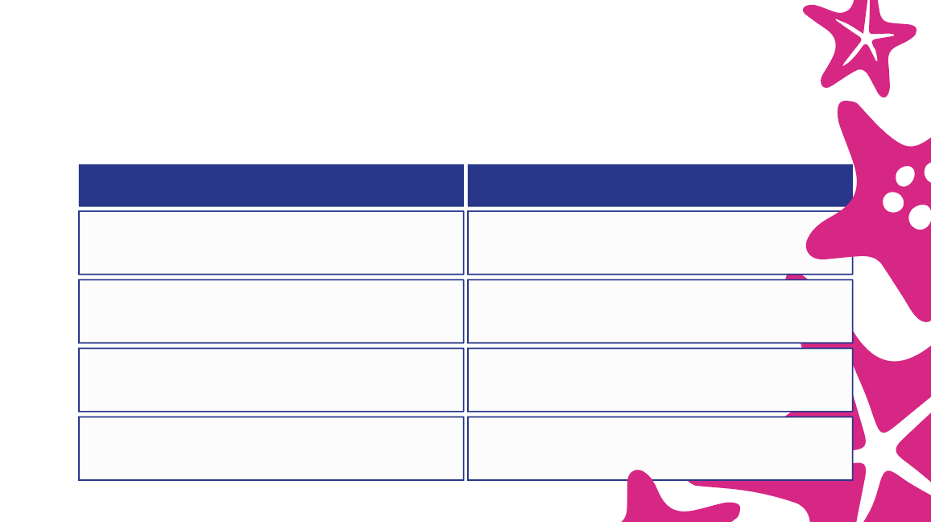
Consider the following problems and come up with possible solutions:
Problem
Solution
Too much is thrown away everyday
The school bins aren’t suitable
People don’t know how to recycle waste
People don’t understand the impact their habits have on the world’s oceans

Slide 9
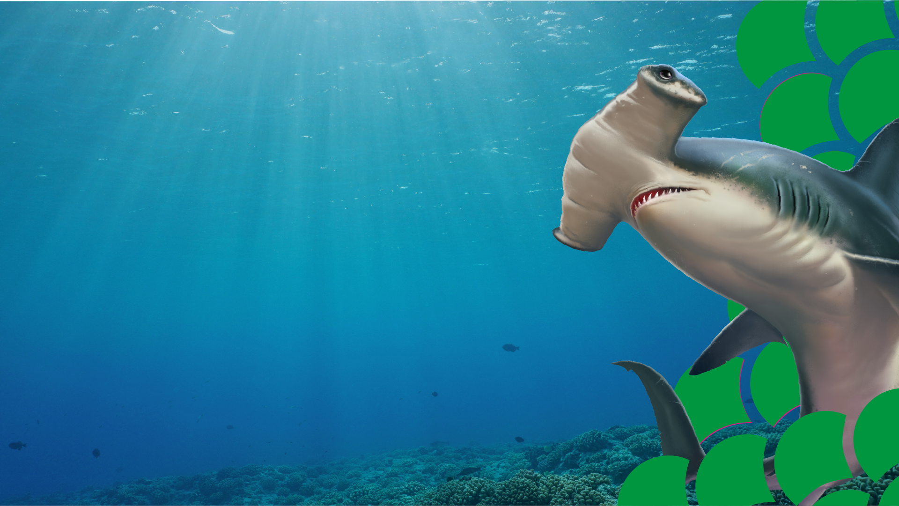
What’s next?
Present your findings to the School Council /
Principal with your ideas for reducing waste.
The title of your presentation should be: ‘How to Become School Recycling Champions’.
Create a timeline of actions and materials,
including posters and leaflets to
support your presentation.
COOL!
EDUCATION

