Slide 1
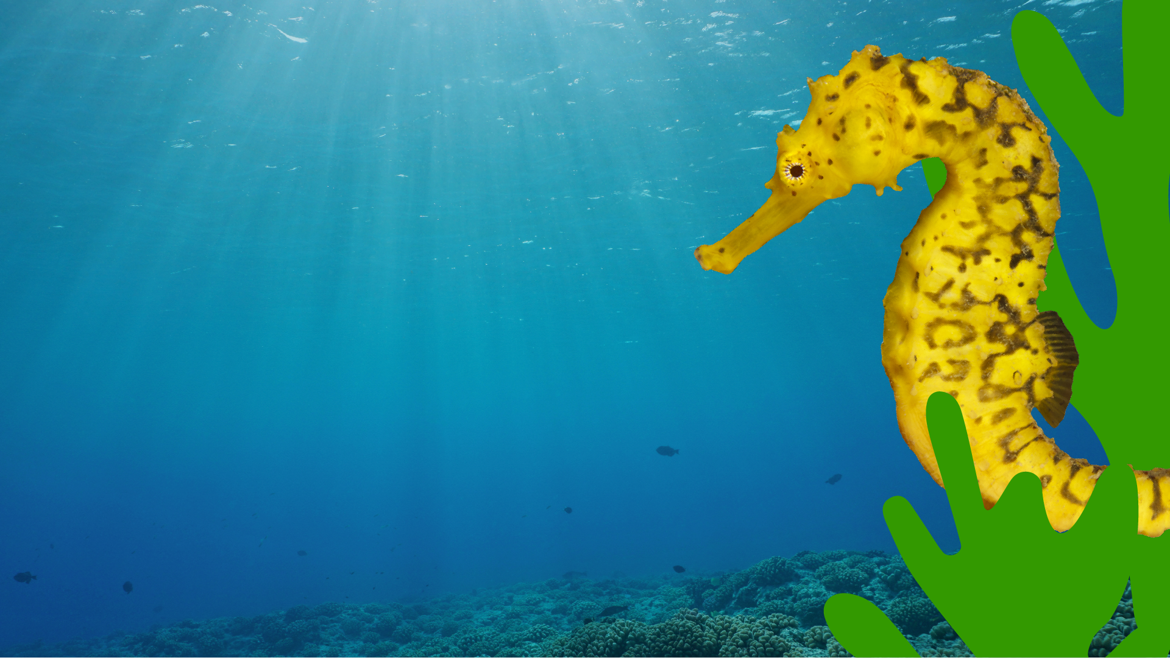
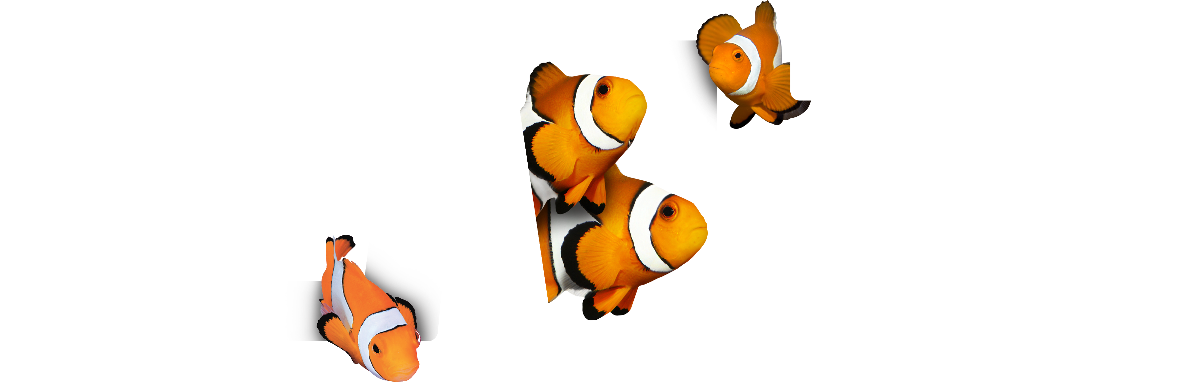
Sea Creature
Creative Writing
Post-Visit Lesson Plan
EDUCATION

Slide 2
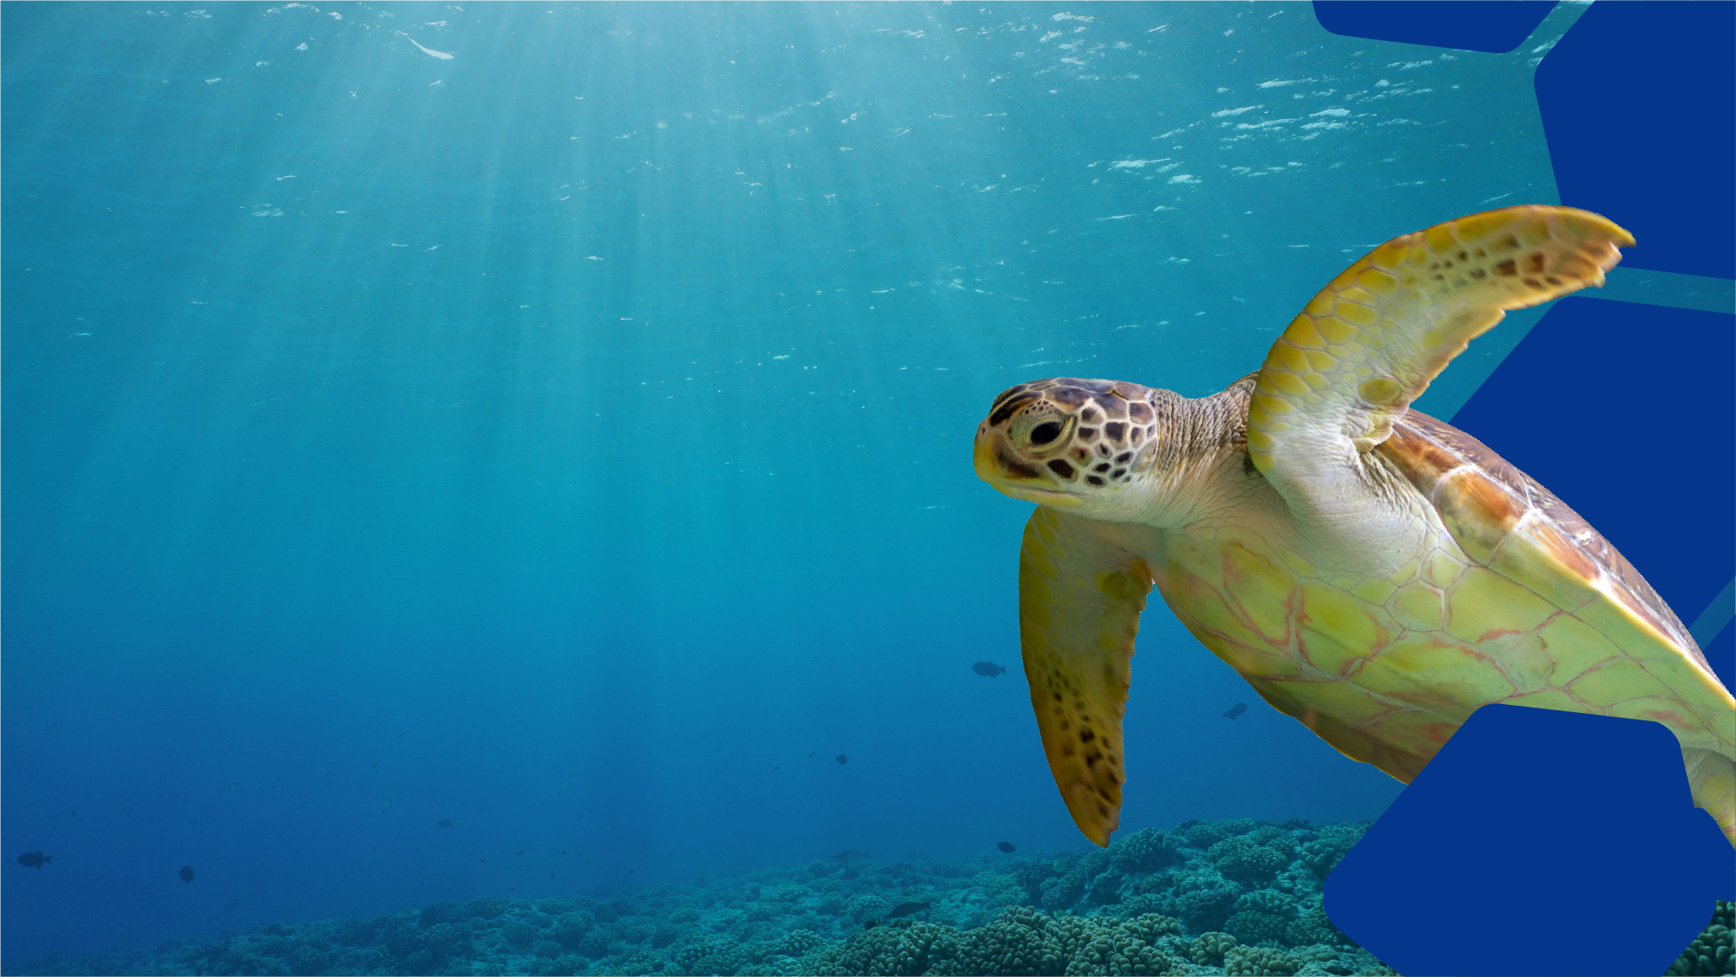
Creative writing inspired by SEA LIFE
Objectives
To write creatively and freely about the SEA LIFE experience
To use appropriate and powerful vocabulary to describe a sea creature
To construct a poem or short story based on a SEA LIFE creature
Outcomes
A passage of free writing inspired by the SEA LIFE
experience.
A list of words and feelings associated with one core sea creature.
A poem or short story about one core creature.
EDUCATION

Slide 3
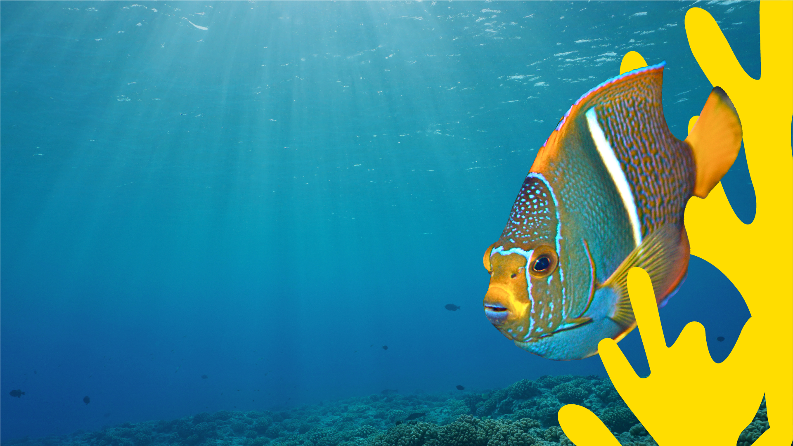
Think back to your visit
to SEA LIFE.
What did you learn?
What did you enjoy most about your visit?
EDUCATION

Slide 4
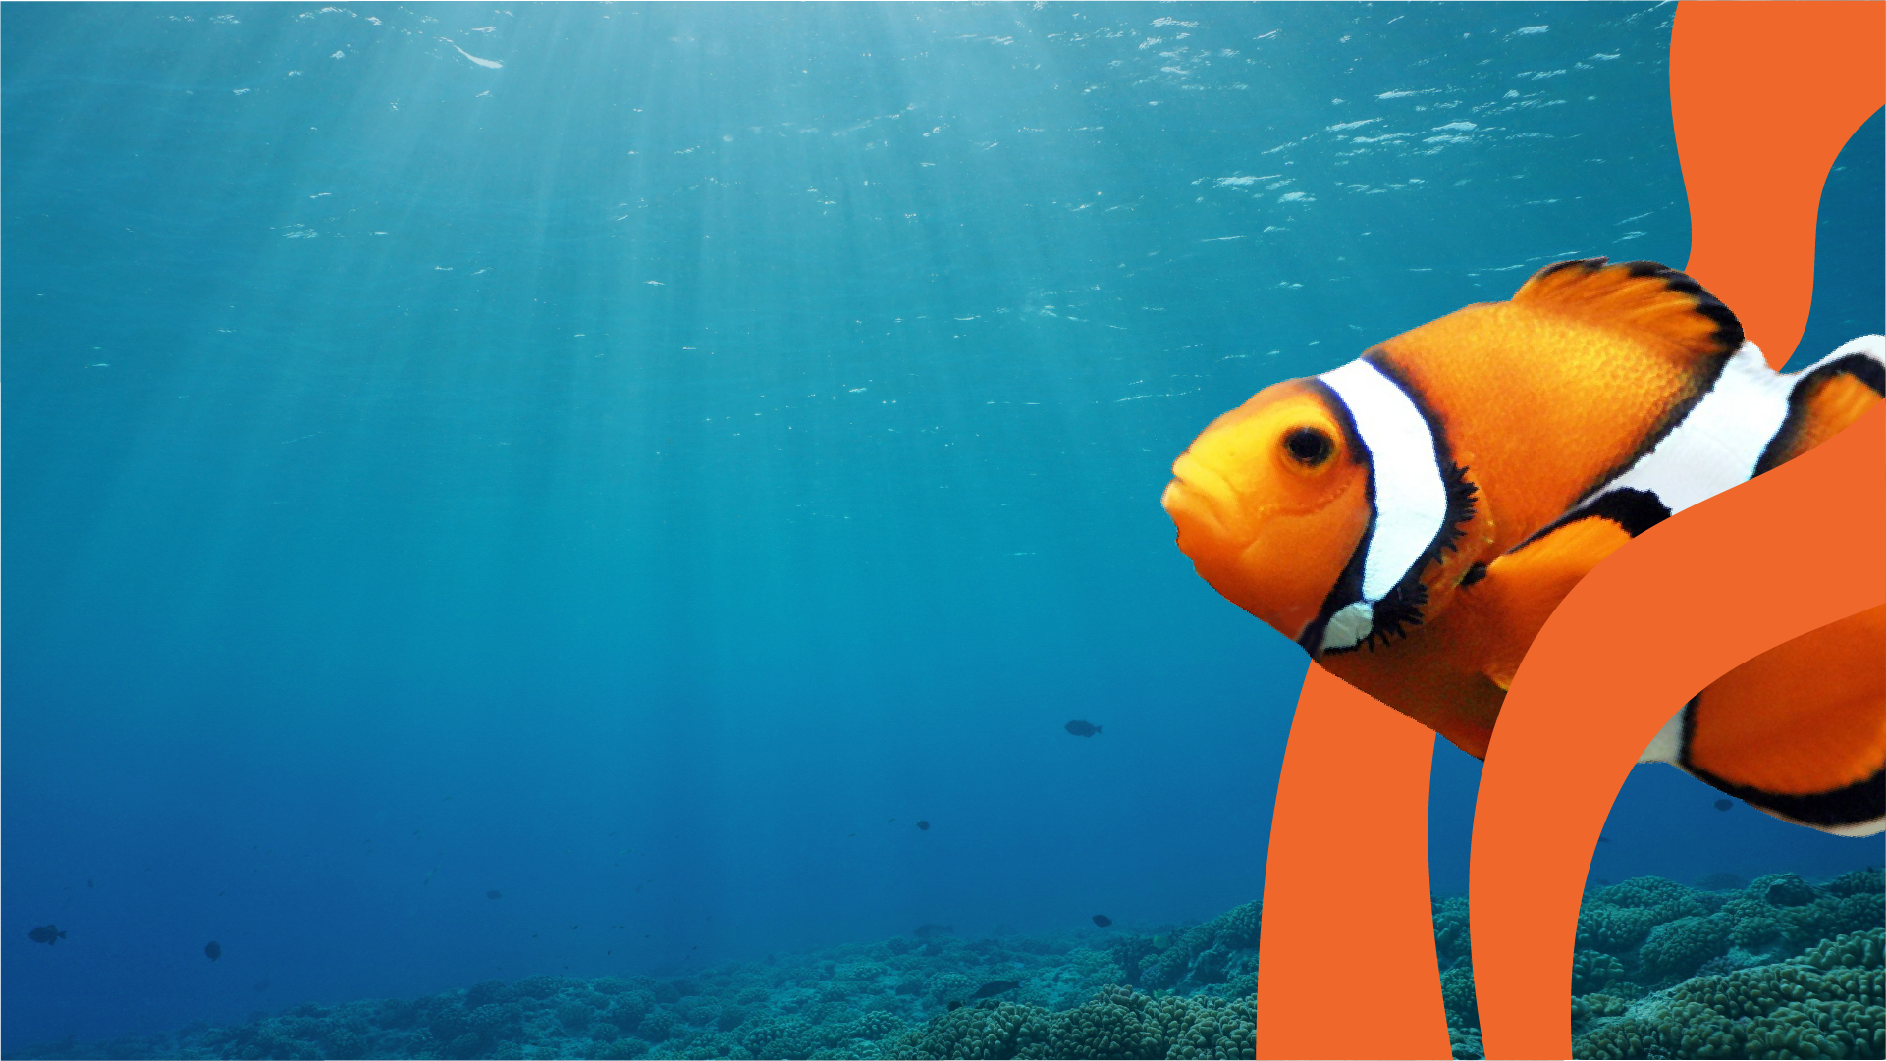
Time to get creative!
First of all, take off your shoes (not socks though - ew!), so that you feel comfortable and ready to write. Remember, this is a private writing task and no one is ever going to read your work.
Ready?
Begin with the words: ‘I remember, I remember, I remember...’ until a thought comes into your head about something you saw or did at SEA LIFE. As soon as it does, write it down! Keep on writing, without stopping, for three minutes. If you get stuck, don't worry - just go back to writing ‘I remember’ until a new thought pops into your head. Simple as that!
EDUCATION
Notes:
Younger students can be encouraged to write “I remember ..” then illustrate their memories to tell a story!

Slide 5
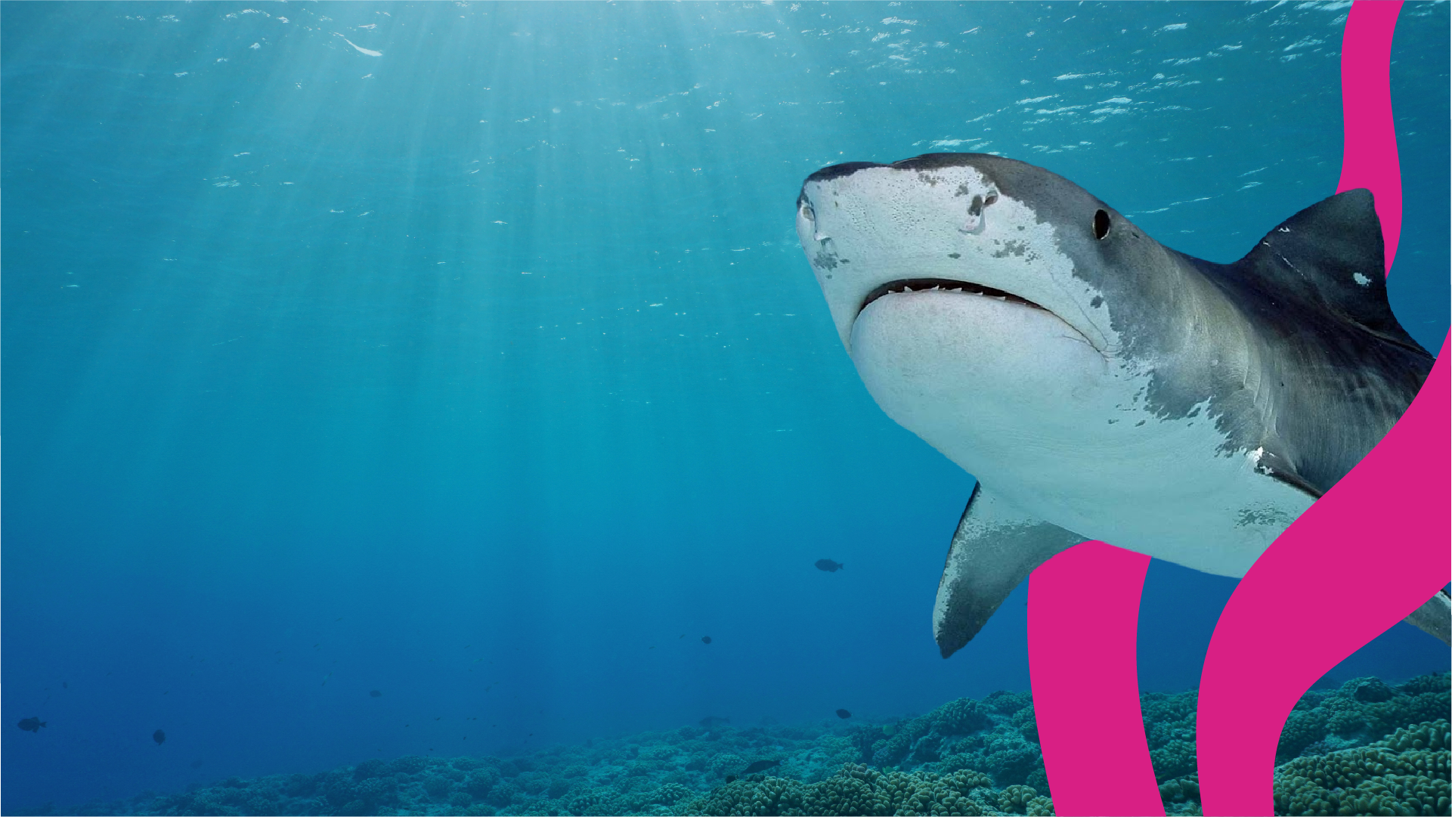
Feedback questions:
Were you surprised
by the thoughts that came to you as you
were writing?
How did you find this
experience?
EDUCATION

Slide 6
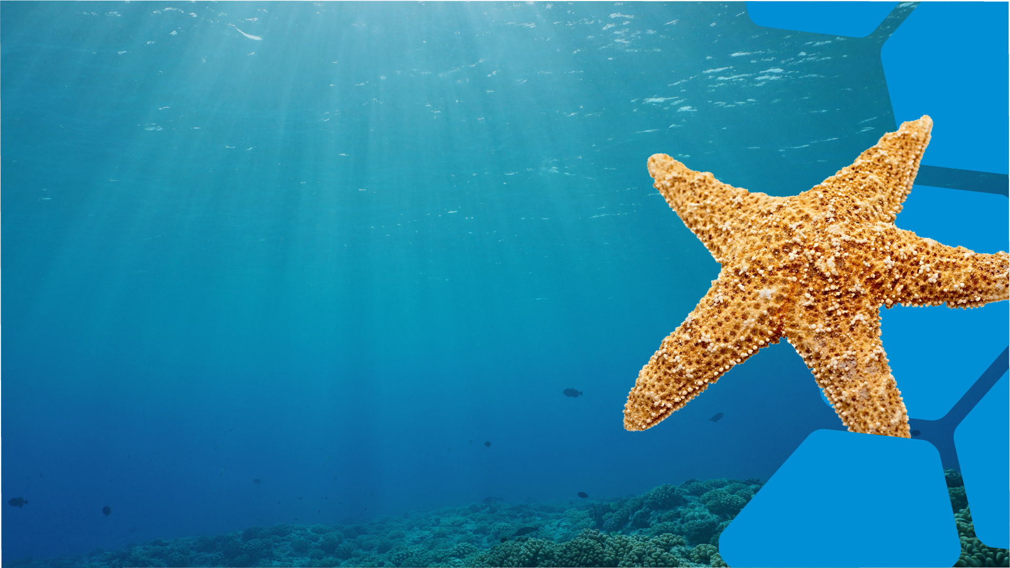

I remember…
Refer back to your anything you took home after your SEA LIFE visit. If you took photographs, ask your teacher if you can print them off and mount them around the classroom to make a display.
Using these as inspiration, write a list of words and feelings to describe one of the creatures you learned about at SEA LIFE.
Cool!
EDUCATION
Notes:
Younger students can work together as a group to create a class list of words!

Slide 7
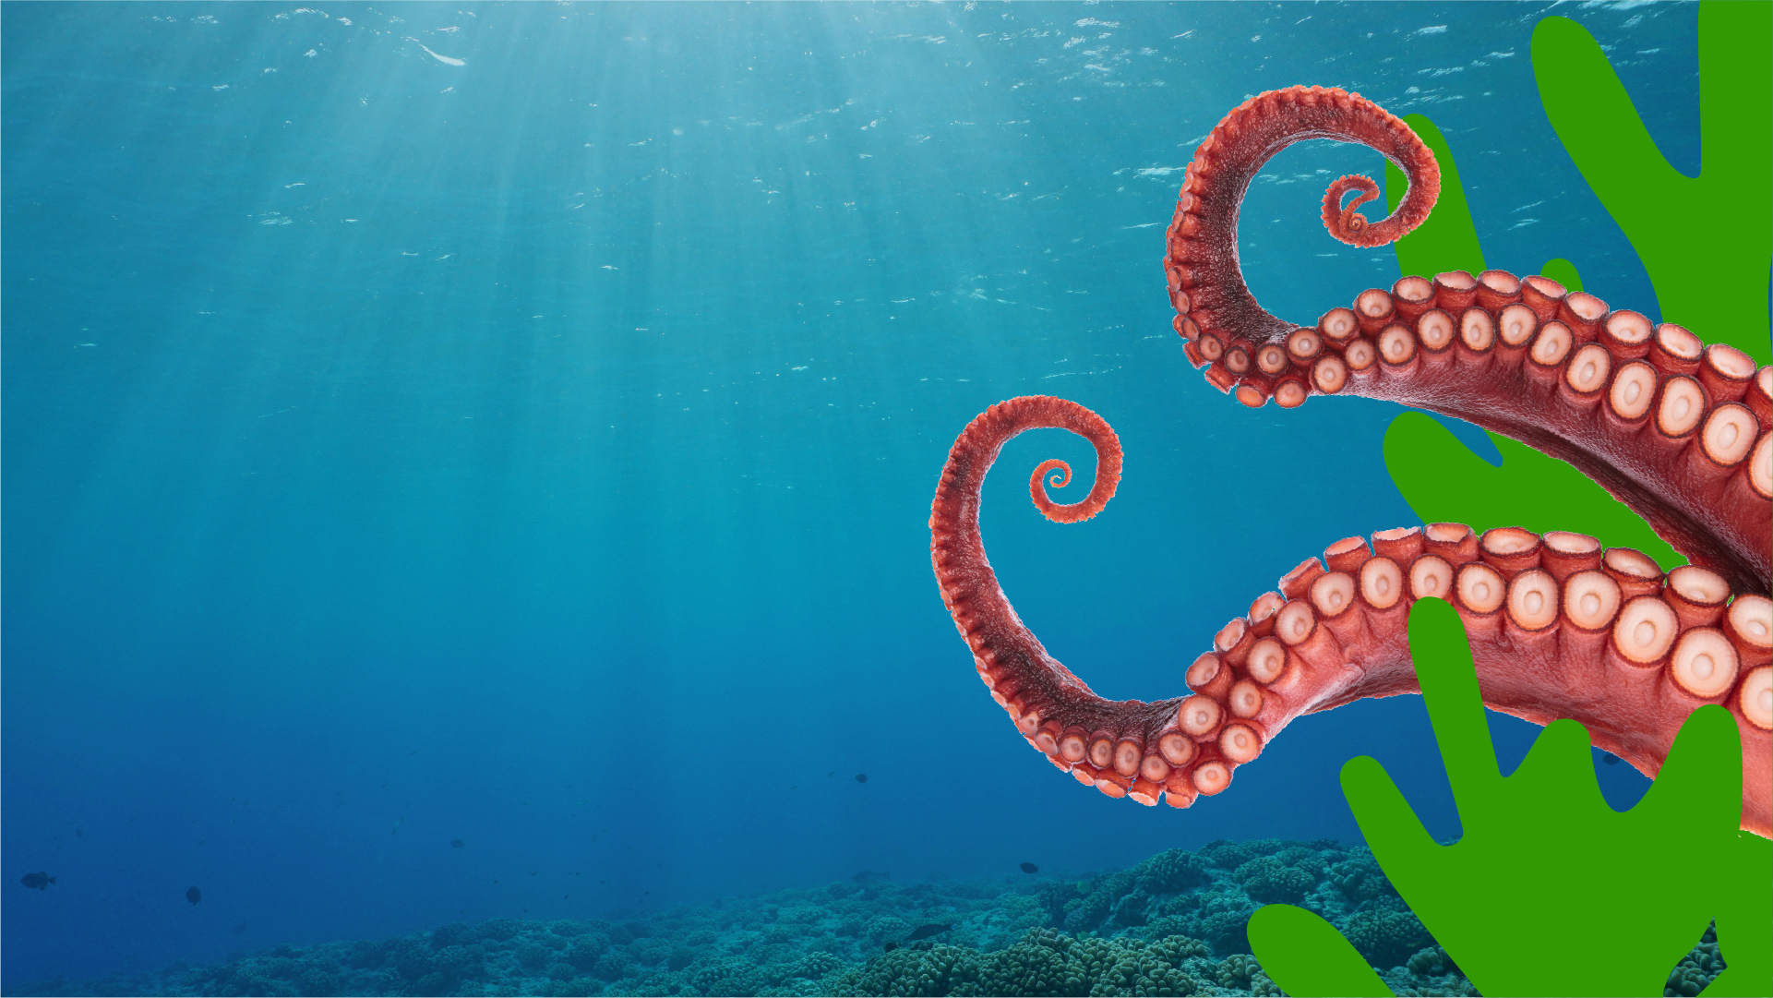

Use the words you came up with in the previous task to write a poem, short story or postcard
inspired by the creature you’ve chosen.
When you have finished, read your poem or
story aloud. Then add it to your SEA LIFE-inspired
classroom display!
Awesome!
EDUCATION
Notes:
Younger students can be encouraged to illustrate their story/poem/postcard then share aloud with the class!

Slide 8

My Creature Postcard

