Slide 1
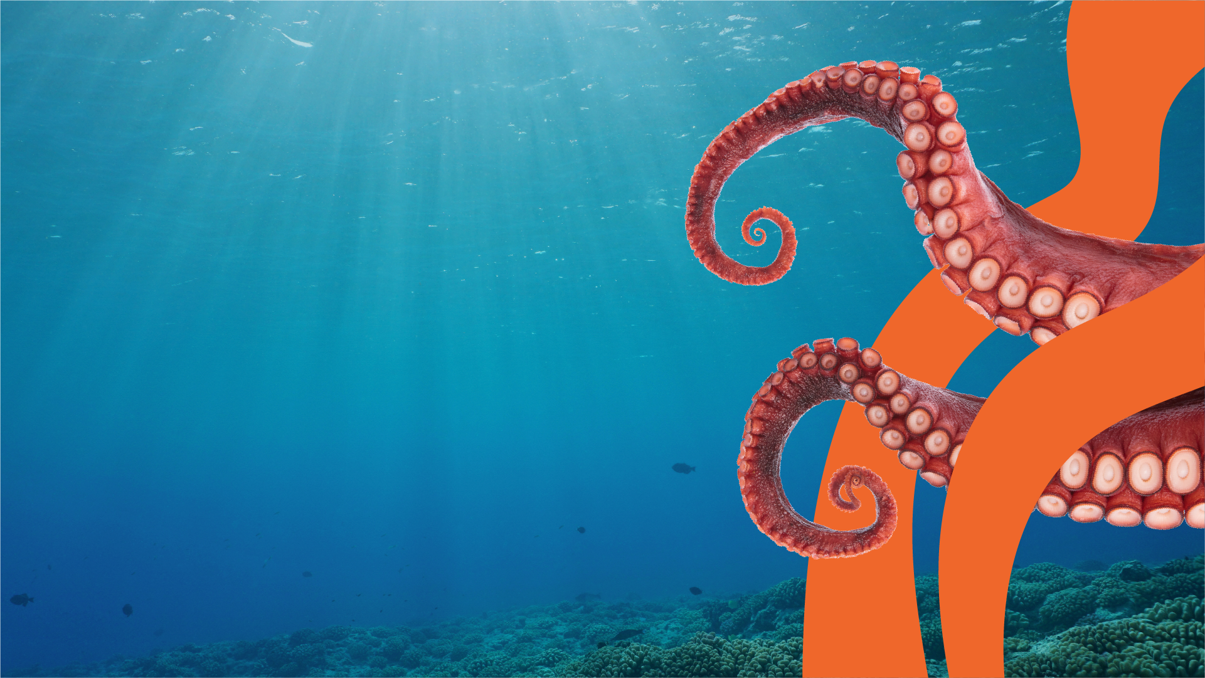

Inheritance
and Variation
Post-Visit Lesson Plan
EDUCATION

Slide 2
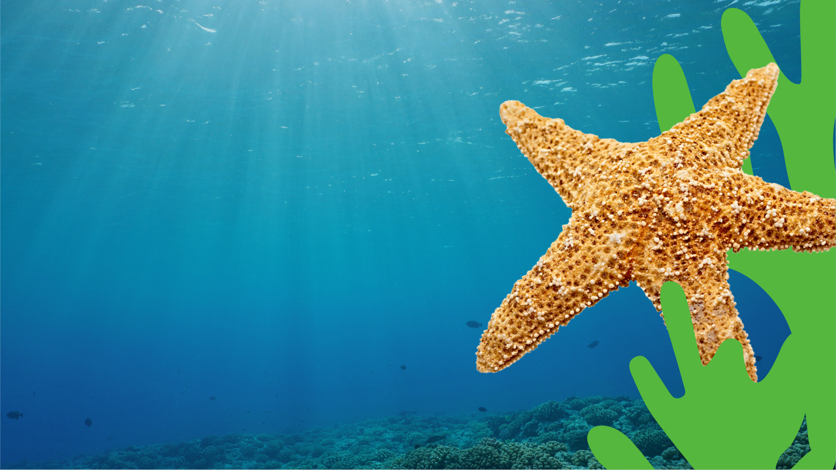
Objectives
To identify inherited characteristics in living things
To understand that variation occurs within offspring as well as across a species
To understand the difference between inherited and environmental characteristics
Outcomes
A completed Inheritance Profile; a list of
inherited and environmental characteristics.
EDUCATION

Slide 3
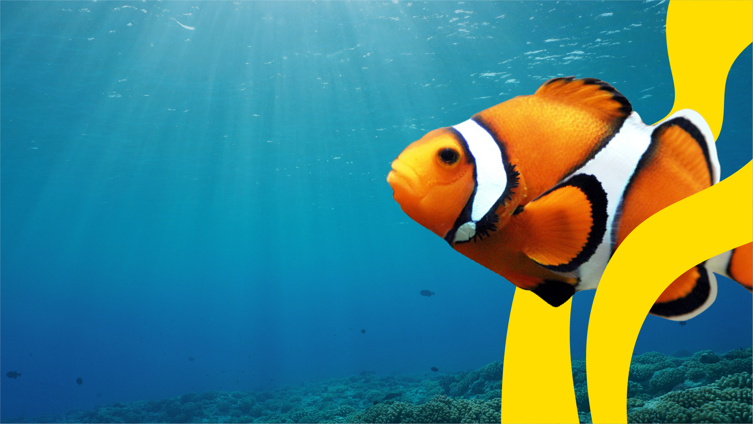
Think back to your visit to SEA LIFE.
What did you learn?
What did you most enjoy about your visit?
EDUCATION

Slide 4
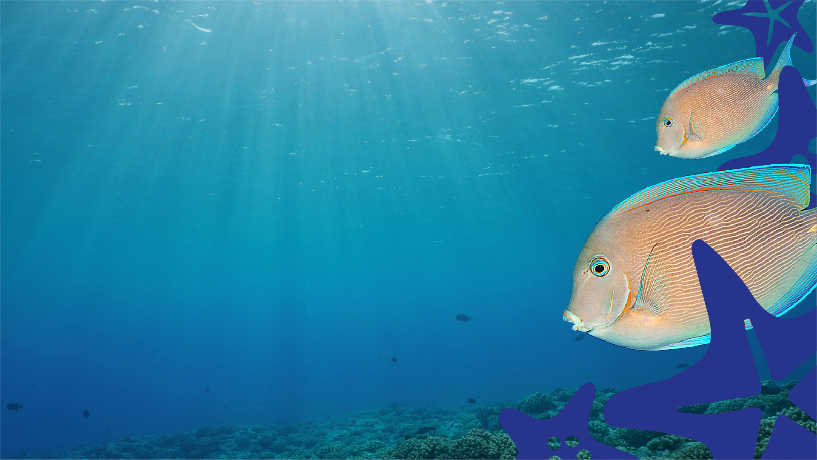
In pairs, describe or look at photos of your parents.
Discuss which characteristics you have inherited from your parents.
A characteristic is a feature of any organism. It can either be ‘seen’
(like the color of your hair) or ‘hidden’ (like your blood type).
Do you share any characteristics with your siblings, or do
they look different than you? Start by thinking about the
following categories:
Eye
color
Hair
color
Face
shape
Ear
lobes
If you don't have a sibling, think about a friend of yours who does. Then share your findings with the class.
EDUCATION

Slide 5

Fill in the Inheritance Profile below by inserting images and notes to show the things you and any of your
siblings have inherited from your parents.
Parent
no. 1
Parent
no. 2
Offspring
no. 1
Offspring
no. 2
Inhereited
Inhereited

Slide 6
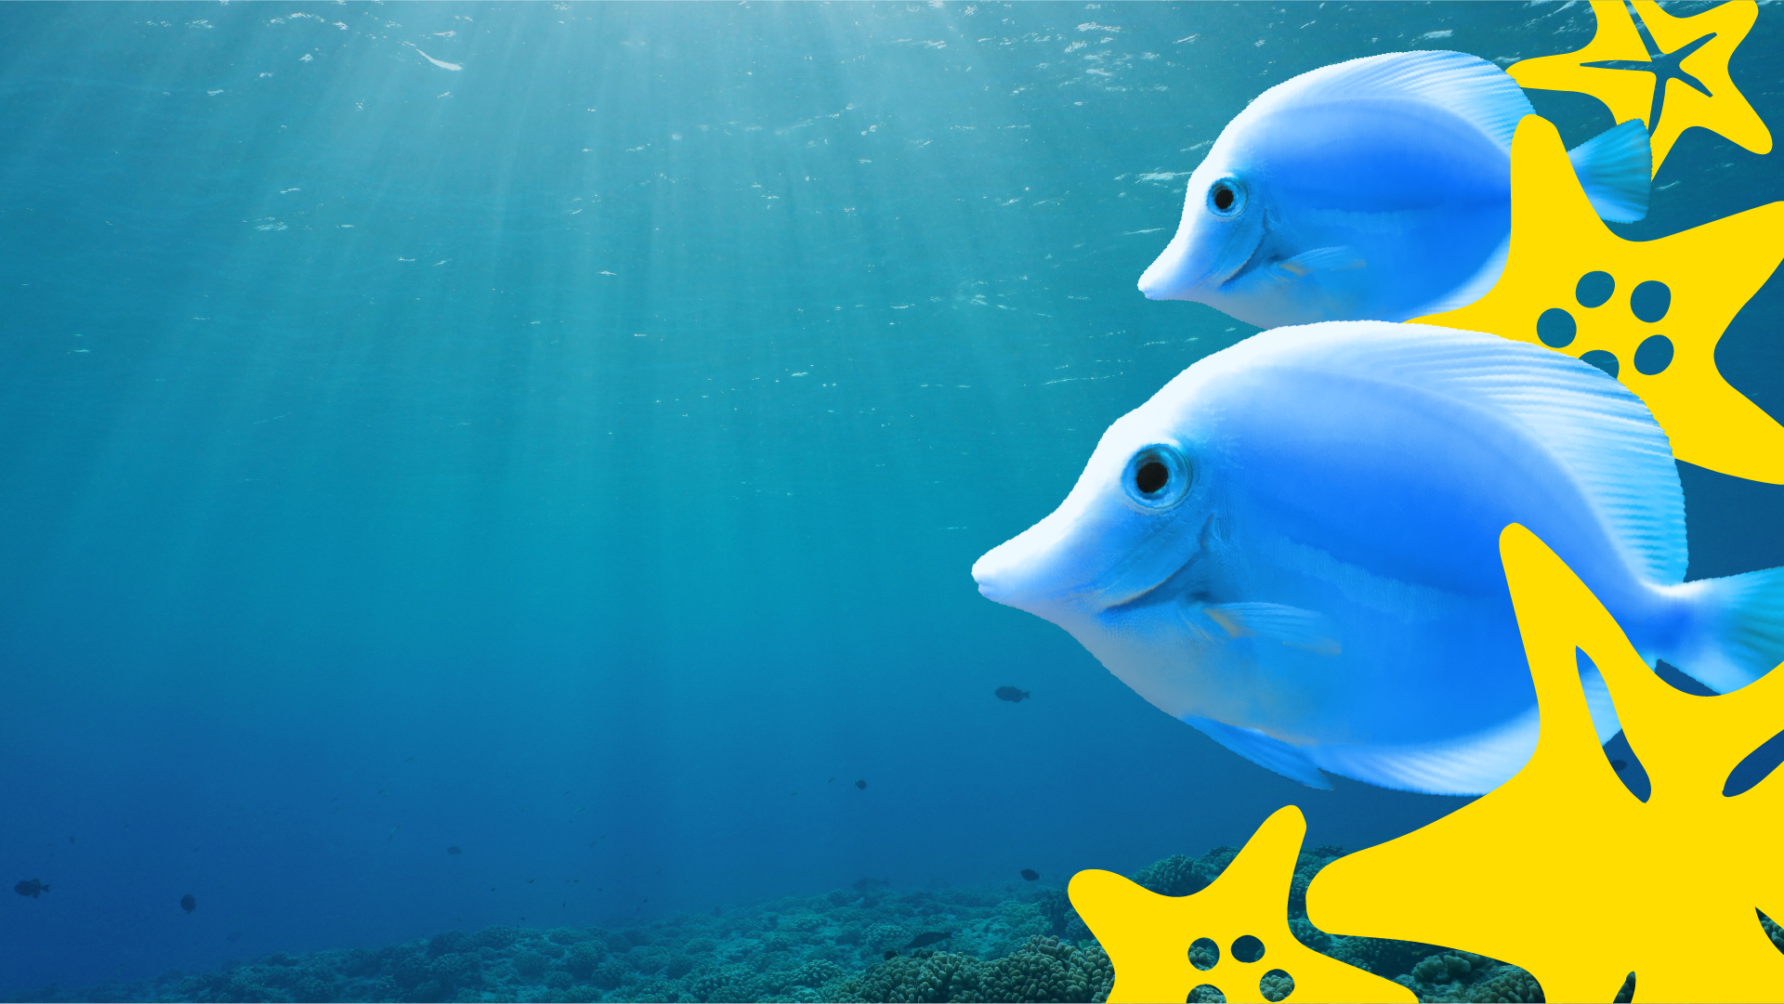
What are the differences
or variations between
you and your siblings?
Some characteristics are ‘inherited' (come
from our parents) through our genes (ex.
eye color and whether or not we have
prominent ear lobes).
While other characteristics come from the life
choices we make and how we live - things like
where we live, what we eat and how much we exercise. These are called ‘environmental
characteristics’.
EDUCATION

Slide 7

Sort the cards below into ‘inherited characteristics’ and ‘environmental characteristics’.
Sort the cards below into ‘inherited characteristics’ and ‘environmental characteristics’.
Eye color
Shape of nose
Language
Migraines
Blood type
Tongue rolling
Natural hair color
Tanned skin from the sun
Height
General health
Weight
Athletic ability
Intelligence
Skin color
EXTENSION: Which characteristics could be considered a combination of
both inherited and environmental characteristics?

Slide 8
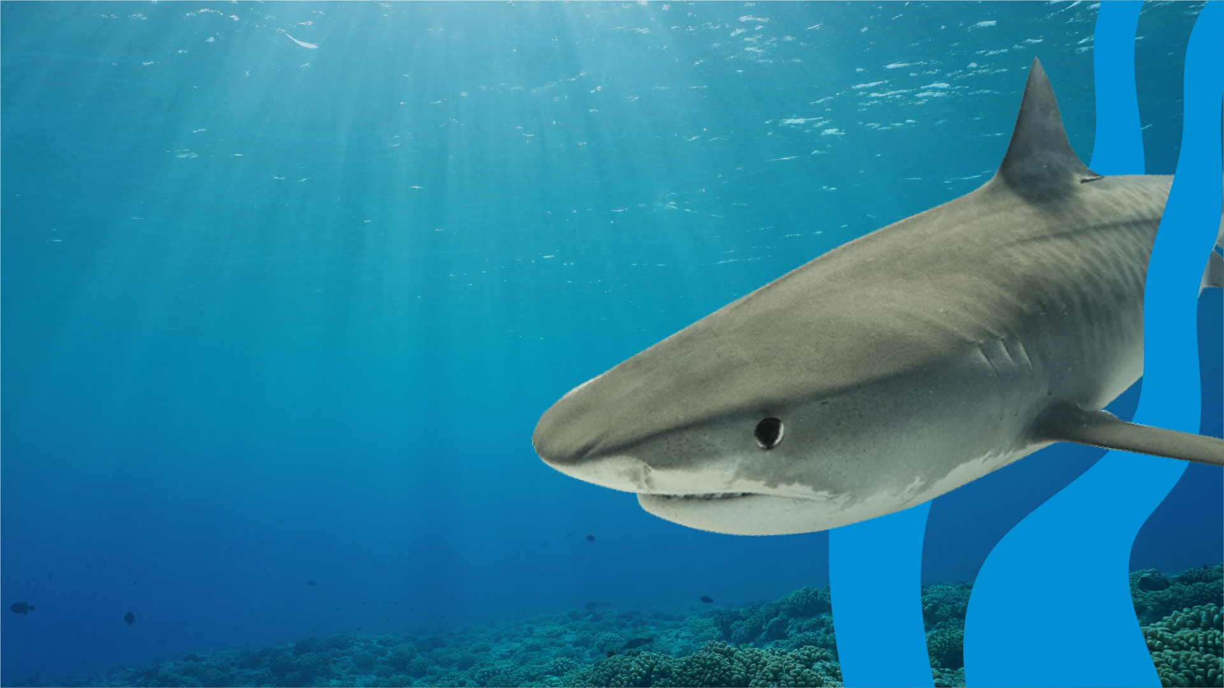
Choose a creature that you
encountered on your SEA LIFE
visit.
Carry out some research
into the inherited and
environmental
characteristics of your
chosen creature.
EDUCATION

